Slide 1

Server Side Request Forgery (SSRF)
Server Side
Request Forgery (SSRF)
Common Weakness Enumeration
The web server receives a URL or similar request from an upstream component and retrieves the contents of this URL, but it does not sufficiently ensure that the request is being sent to the expected destination.
Open Web Application Security Project
A successful SSRF attack can grant the attacker access to restricted actions, internal services, or internal files within the application or the organization. In some cases, it can even lead to Remote Code Execution (RCE).

Slide 2
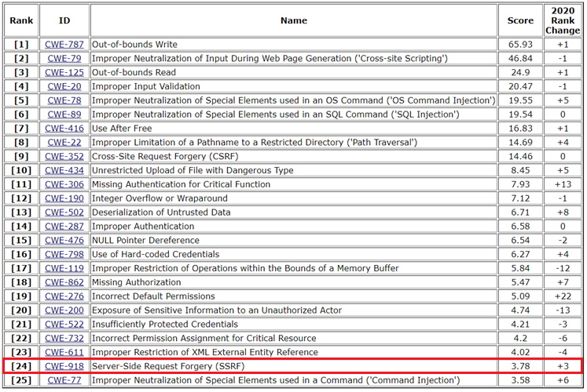
RANKINGS
https://cwe.mitre.org/top25/archive/2021/2021_cwe_top25.html

Slide 3
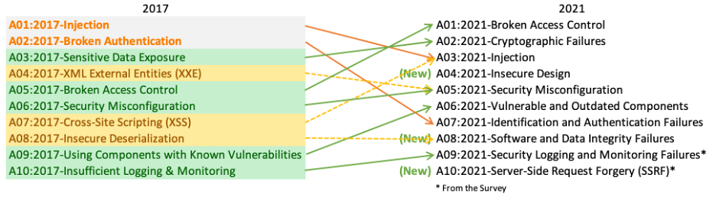
RANKINGS
https://owasp.org/www-project-top-ten/

Slide 4
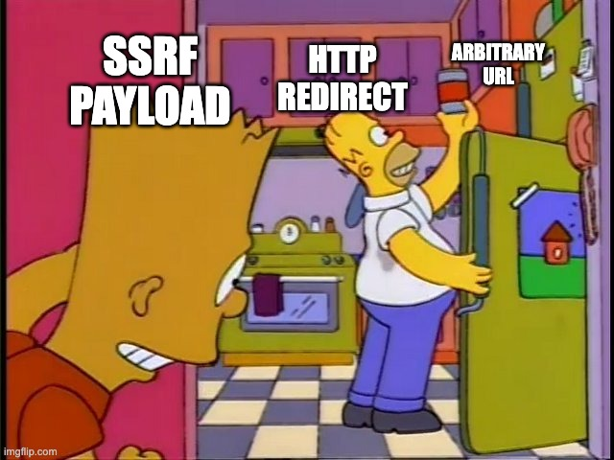
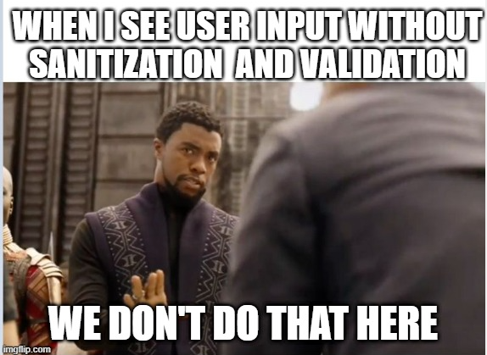

Slide 5
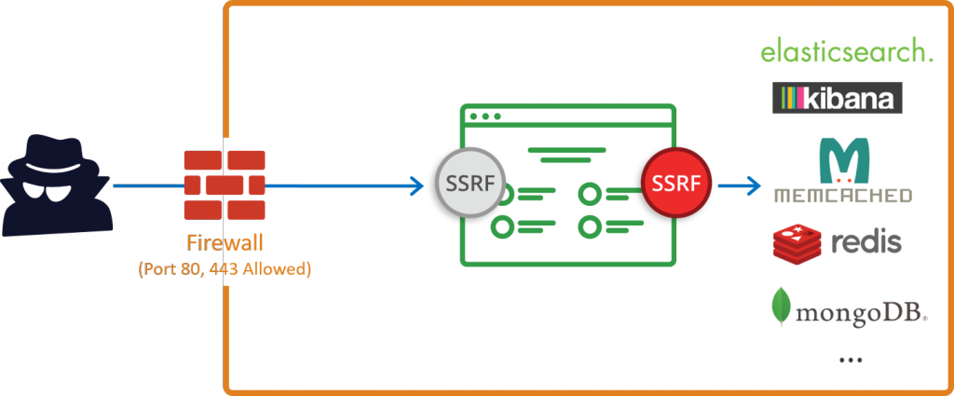
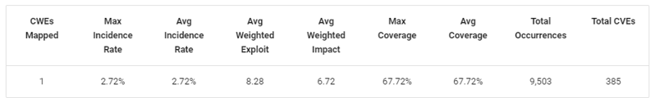
Comment: Incidence rate of SSRF is realitively low however this class of attacks (it is not a vulnerability) is extremely critical!

Slide 6
Reasons of SSRF
Application performs requests to a server
Hacker has full or partial control over the request
Opened ports
Bypassing regexes
Lack of data validation&sanitization before execution on server side
Vulnerable modules/libraries in programming languages

Slide 7
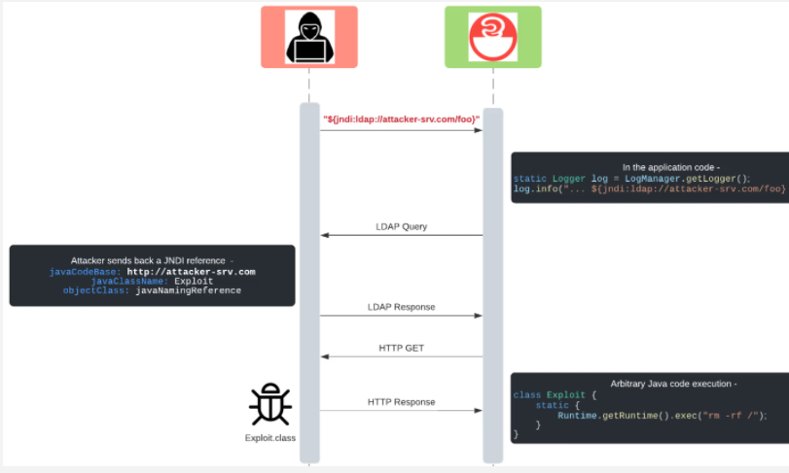
Example of vulnerable library

Slide 8
Three main types of Server Side Request Forgery attacks
1. Incjecting SSRF payloads
2. XSPA (Cross-Site Port Attack) Scanning for open ports
3. Obtaining access to metadata in cloud environments (AWS, OpenStack, GCP…)
Impact of SSRF
Generally, reaching out to the internal assets which are not accessible to the user from outside. So attacker do that on behalf of SERVER.

Slide 9
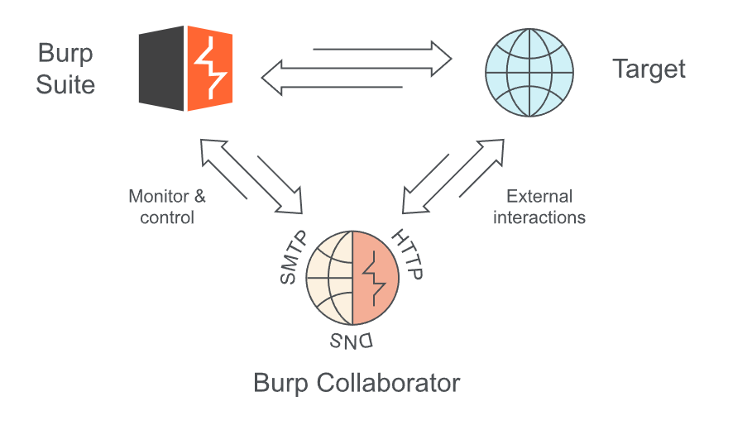
Blind SSRF vulnerabilities?
What do you mean by ’Blind’?
-> This vulnerability occurs when back-end of application performs request to the URL supplied by attacker however the result of this action won’t be shown to the front-end.
So regarding to the fully informed SSRF-type attack, they are not being easily exploited.
OUT-OF-BAND APPLICATION SECURITY TESTING (OAST)?
-> Triggering request to an external system which we control as well as we can check whether there are replies from the attacked server – any interactions. It helps to see invisible vulnerabilities

Slide 10
How to look for SSRF?
Accessing files/data with different protocols (file://... dict://… SFTP://… TFTP://… LDAP://… Gopher://... and many others…) e.g.
-> <iframe src=’’file:///etc/passwd’’ width=’’400’’ height=’’400’’>
Bypassing local IPs (http://3232235777/, http://0.0.0.0:80 , http://127.0.0.1#{domain}, …)
-> https://github.com/swisskyrepo/PayloadsAllTheThings/tree/master/Server%20Side%20Request%20Forgery
DNS spoofing (passing data to the server e.g. ’’?url= 1.my-test-domain.com’’ where DNS record is mapped (try-hard method):
1.my-test-domain.com -> 192.168.1.1
2.my-test-domain.com -> 192.168.1.2
…
254.my-test-domain.com -> 192.168.1.254
(example of enumeration!)
DNS pinning (e.g. XIP.IO, this technique might used in development environments)
-> http://testp.app.127.0.0.1.xip.io
Checking paths which might be only served locally, called private content e.g. http://127.0.0.1/admin (see 2nd point)
Scan ports, networks…!!!! Use advanced tools like SSRFmap
Accessing metadata from cloud provider services e.g. (169.254.169.254 IP address is a “magic” IP in the cloud world)
-> (AWS) https://app.com/page?url=http://169.254.169.254/latest/meta-data/iam/security-credentials/s3access
-> (Azure) https://target.com/page?url=http://169.254.169.254/metadata/instance/network/interface/0/ipv4/ipAddress/0/publicIpAddress?api-version=2019-10-01&format=text (Requres header Metadata: true, azure is more limited taking into consideration this case)

Slide 11
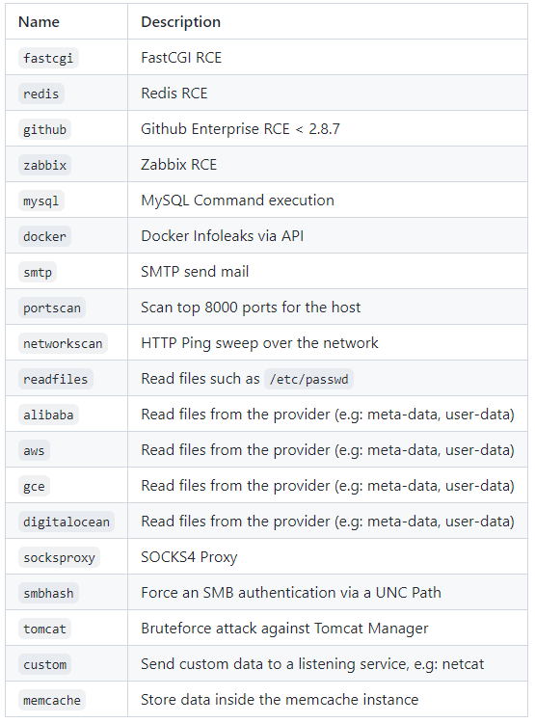
SSRFmap
https://github.com/swisskyrepo/SSRFmap
-> Tool used for testing applications against
SSRF-type vulnerabilities
-> Offering specific penetration tests regarding to the app-type
-> Automation!
-> Simplicity!

Slide 12
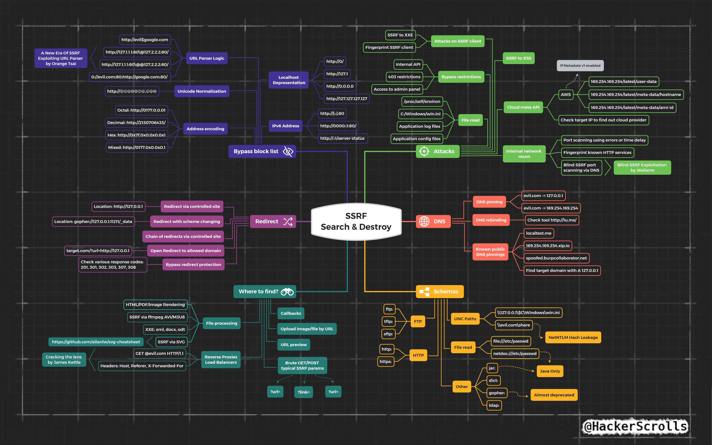

Slide 13
Blacklist
It ALLOWS AN ACCESS to assets with mentioned exceptions
Should be reviewed regularly as well as updated
To work properly, there must be huge number of entries!

Slide 14
Blacklist
http://127.0.0.1 = http://127.1
http://127.0.0.1 = http://2130706433
http://127.0.0.1 = http://①②⑦.⓪.⓪.①
http://127.0.0.1 = http://localhost
http://localhost = http://LoCaLhOsT
http://127.0.0.1 = http://0x7f000001
http://127.0.0.1 = http://017700000001
http://127.0.0.1 = http://0x7f.0.0.①

Slide 15
Whitelist
It PREVENTS FROM ACCESSING the assets with some exceptions
Number of entries depends on number of trusted IPs, domains, etc.
Should be regularly reviewed as well as depleted with obsolete addresses
example.com#cisco.com
cisco.com@example.com

Slide 16
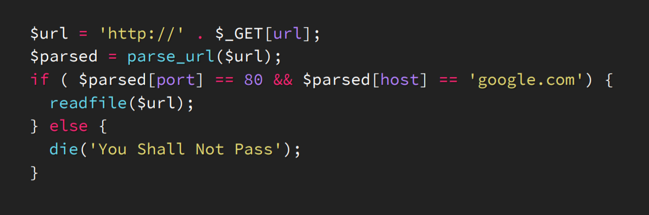
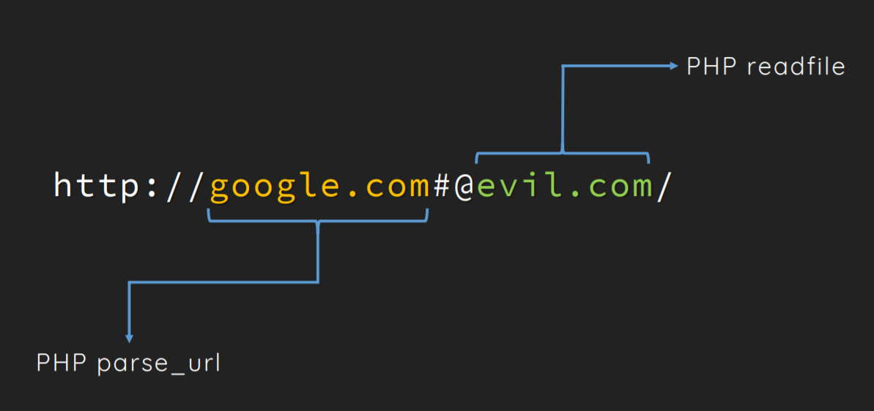
Example

Slide 17
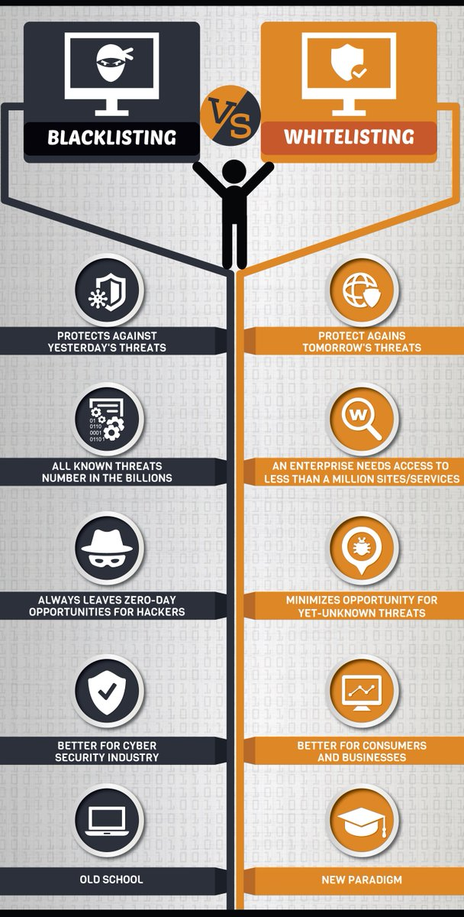
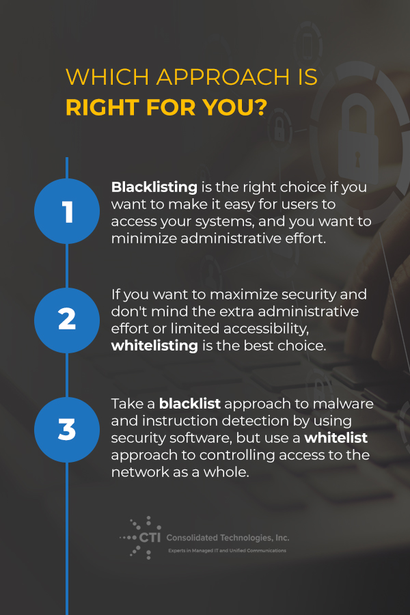
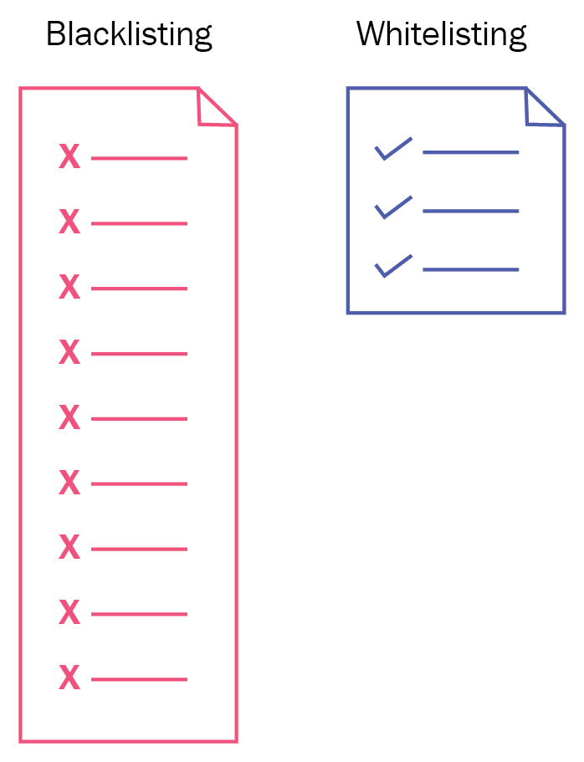

Slide 18
Other mitigations in (L7 || L3)
Firewalls
- On networking equipment or host based (outbound direction)
Smokescreen (HTTP CONNECT proxy)
- Restrict which URLs it connects to. Checking if requests are being made to internal services. (ACL + Tunneling)
Control Callback
- CIDR checks and limit HTTP redirects

Slide 19
IMDS
METADATA SERVICE is responsible for managment and storage of keys, tokens…
Assuming that we want to restart AWS E2 service, we must firstly connect to INSTANCE METADATA SERVICE
METADATA SERVICE has got fixed, identical IP address for every instance – 169.254.169.254
Basiclly METADATA SERVICE is not protected by any autethication or crypthography method
INSTANCE METADATA SERVICE is accesible only from within instance itself

Slide 20
IMDS
Any problems? SSRF
How to ?
0. For example simple web server running on the EC2 instance which is able to make get request to any address.
1. Request to http://169.254.169.254/latest/meta-data/iam/security-credentials/
2. Request to http://169.254.169.254/latest/meta-data/iam/security-credentials/*iam role from 1.*/
3. Security credentials are ours ;)

Slide 21
IMDS
Any idea for solution?
1. Limit access to IMDS (if not in use -> turn it off)
2. Lock down IMDS to specyfic user (ex. root)
3. Validation of addresses and discarding 169.254.169.254 – very difficult to implement

Slide 22

IMDS
Real life example:
Best solution -> upgrade to IMDSv2

Slide 23
IMDSv2
First contact with Metadata Service
For sending data over the internet, we use usually methods like GET/POST
IMDSv2 forces us to use relatively rare method PUT
Extra header: X-aws-ec2-metadata-token-ttl-seconds

Slide 24
IMDSv2
Response packets from METADATA SERVICE are coming with ttl set to 1
We can use GET method
Although we must add to the header (X-aws-ec2-metadata-token) TOKEN which we obtained before
TOKEN=`curl -X PUT "http://169.254.169.254/latest/api/token" -H "X-aws-ec2-metadata-token-ttl-seconds: 21600"`
curl http://169.254.169.254/latest/meta-data/profile -H "X-aws-ec2-metadata-token: $TOKEN„

Slide 25
Tasks to do :D
Delete user Carlos
Delete user Carlos bypassing whitelist filter
Delete user Carlos bypassing blacklist filter
Delete user Carlos taking into consideration fact that endpoint which is responsible for deleting users is implemented on different instance

